Slide 1
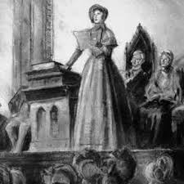
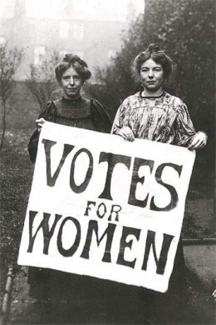
Thy Voice
Will Be
Heard...
The Women’s
Manifesto

Slide 2
The Women’s Struggle for Equality…
Here we have hidden, behind masked doors, with no place to proclaim. But we are tired of staying concealed. We will hide no more. We will earn our rights and freedoms. We are women, we are people, and thy voice will be heard! No more oppression will be tolerated. We must reach equality for our gender, for our society could not exist without women bearing the lives of humanity. We must educate ourselves and be taught that we are capable of being worthy and valuable to the workforce. We deserve equal treatment, for we all work just as hard. We are not just child-bearers and housewives; we are capable of thought and reason within ourselves. We are not puppets for their pleasure; we are not slaves who can be controlled. We do not need men to tell us how to think. We will no longer stand for this injustice!
We are women, we are people, and thy voice will be heard!

Slide 3
There are three things we must fight for!
I: Education
II: Our Rights
III: Our Freedoms

Slide 4
I: Education
We must be educated, for which there is no space for reason without it. Men have the right to speak their minds and learn of what they choose. This should not be a right only given to the white man! We are capable of logic and thought. Women have proven themselves enough to be equal members in society. As in the words of the great feminist Mary Wollstonecraft, “Men and women must be educated, in a great degree, by the opinions and manners of the society they live in.” If men are the only ones to receive education, then we will never be equals. They will always feel they are more knowledgeable, which gives them to power to rule over our gender. Education will provide us with the accurate tools to create change and gain equality. We must value our minds and the power it creates within our beings. We have worked so hard and for what? Callousness? No! We cannot accept that this is the only life we deserve! Education will lead us to a life without questions we cannot answer. We will not be held back any longer from the potential we are capable of reaching! Let us set forth a fight for education for all women because we obligate the right to learn!

Slide 5
II: Our Rights
We as humans should be given natural rights. Society has taken those away from us! This is a new age and it is time for women to be equal partners in government. We must stand up for the right to vote, for it is the basis of all decision- making in democracy. We must fight for the right of fair treatment and equal opportunities for women in the workforce. No longer will we tolerate being kept in our homes to work only as slaves to our families. We require the resources to learn and spread the word of our mistreatment. We deserve the right to fair wages so we can be providers for our families and earn our own livelihood. Consider how we could improve the workforce and economy with all of the women who are able to work. Marriage should not be a suppressing contract of our sex! We must fight for love and equality. No longer will we stand for being controlled by the man! We have desires that deserve to be heard and practiced. We must always uphold our moral values, but never to the extent to be forced to obey commands. We obligate the right to command ourselves, as long as we are just!

Slide 6
III: Our Freedoms
We are provided rights by our Constitution, which have been stolen from us. We must understand our freedoms and use them to create change for future generations. The freedom of speech is the means we must use to declare our rights. We have a choice to make, and if we do not speak out against this discrimination, then no change is possible. The freedom of the press provides us with an opportunity. We must put our motions into writing and spread our cause to establish action. We must fight the stereotypes of women! For we are not weak! We will no longer be submissive. We will no longer be quiet. Our freedoms must be valued to the fullest extent of the law. We must change policies so they can provide equal opportunity and permanent freedom. Let us take action and fight until we reach our goals. We will never give up!

Slide 7
This is the year we will create change! Support us and never stop fighting for what we deserve! We can revolutionize history!!
1848

Slide 8
We are Women, We are People, and Thy Voice Will Be Heard!

Slide 9
Cites:
http://dwbproductions.hubpages.com/hub/Womens-rights-in-the-1800s-America
http://griid.org/2012/07/19/this-day-in-resistance-history-declaration-of-sentiments-at-womens-rights-convention-seneca-falls-1848/
https://www.nwhm.org/online-exhibits/rightsforwomen/abolitionandsuffrage.html
http://www.connerprairie.org/learn-and-do/indiana-history/america-1860-1900/lives-of-women.aspx
http://chnm.gmu.edu/exploring/19thcentury/womenandequality/
http://www.wic.org/misc/history.htm
http://www.npg.si.edu/col/seneca/senfalls1.htm
https://www.marxists.org/archive/marx/works/1848/communist-manifesto/
Broomfield, Andrea, and Mitchell, Sally. Prose by Victorian Women: An Anthology.
New York: Garland Pub., 1996. Print.

